Slide 1
Build An Emergency Kit for personal and Family Preparedness

Slide 2
“The Big 3”
• Water, one gallon of water per person per day for at least three days, for drinking and sanitation
• Food, at least a three-day supply of non-perishable food
• Medicine, at least three days worth. (First Aid Kit)

Slide 3
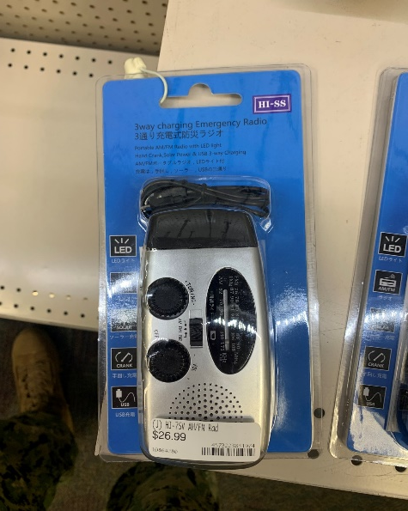
“Basic Disaster Supplies Kit”
Battery-powered or hand crank radio and a NOAA Weather Radio with tone alert
Flashlight
Extra batteries
Whistle (to signal for help)
Dust mask (to help filter contaminated air)
Plastic sheeting and duct tape (to shelter in place)
Moist towelettes, garbage bags and plastic ties (for personal sanitation)
Wrench or pliers (to turn off utilities)
Manual can opener (for food)
Local maps
Cell phone with chargers and a backup battery

Slide 4
“Personalize Your Kit”
Masks (for everyone ages 2 and above), soap, hand sanitizer, disinfecting wipes to disinfect surfaces
Prescription medications. About half of all Americans take a prescription medicine every day. An emergency can make it difficult for them to refill their prescription or to find an open pharmacy. Organize and protect your prescriptions, over-the-counter drugs, and vitamins to prepare for an emergency.
Non-prescription medications such as pain relievers, anti-diarrhea medication, antacids or laxatives
Prescription eyeglasses and contact lens solution
Infant formula, bottles, diapers, wipes and diaper rash cream
Pet food and extra water for your pet
Cash or traveler's checks
Important family documents such as copies of insurance policies, identification and bank account records saved electronically or in a waterproof, portable container
Sleeping bag or warm blanket for each person
Complete change of clothing appropriate for your climate and sturdy shoes
Fire extinguisher
Matches in a waterproof container
Personal hygiene items
Mess kits, paper cups, plates, paper towels and plastic utensils
Paper and pencil
Books, games, puzzles or other activities for children

Slide 5
“Maintaining Your Kit”
After assembling your kit remember to maintain it so it’s ready when needed:
Keep canned food in a cool, dry place.
Store boxed food in tightly closed plastic or metal containers.
Replace expired items as needed.
Re-think your needs every year and update your kit as your family’s needs change.

Slide 6
“Kit Storage Locations”
Since you do not know where you will be when an emergency occurs, prepare supplies for home, work and cars.
Home: Keep this kit in a designated place and have it ready in case you have to leave your home quickly. Make sure all family members know where the kit is kept.
Work: Be prepared to shelter at work for at least 24 hours. Your work kit should include food, water and other necessities like medicines, as well as comfortable walking shoes, stored in a “grab and go” case.
Car: In case you are stranded, keep a kit of emergency supplies in your car.

Slide 7
“Reference’s”
https://www.cnic.navy.mil/regions/cnrj/installations/cfa_yokosuka/om/emergency_management.html
Or GOOGLE “ Emergency Management Yokosuka”
https://www.ready.gov/

Slide 8
BE PREPARED!!

